Slide 1

Exposure Therapy
Real-Time Speech & Emotion Analysis with Adaptive Coaching
Team No:43
Team Name: Codemax

Slide 2
Presentation Overview
01
02
Setting the Stage
Deep Dive into Technology
Introduction to the problem and our innovative solution.
Unpacking the AR/VR powering our prototype.
03
04
Vision for the Future
Why We Stand Out
Exploring unique features and our strategic roadmap.
Competitive advantages and next steps for investment.

Slide 3


The Challenge: Conquering Public Speaking Anxiety
The Nervous Speaker
The Disengaged Audience
Many people struggle with public speaking due to a critical lack of immediate, constructive feedback. This often leads to reduced confidence and difficulty in managing emotional responses during presentations.
Without proper preparation and emotional control, speakers often fail to connect with their audience, resulting in disinterest and missed opportunities for impact.
"Over 70% of people experience significant anxiety when speaking in public."

Slide 4
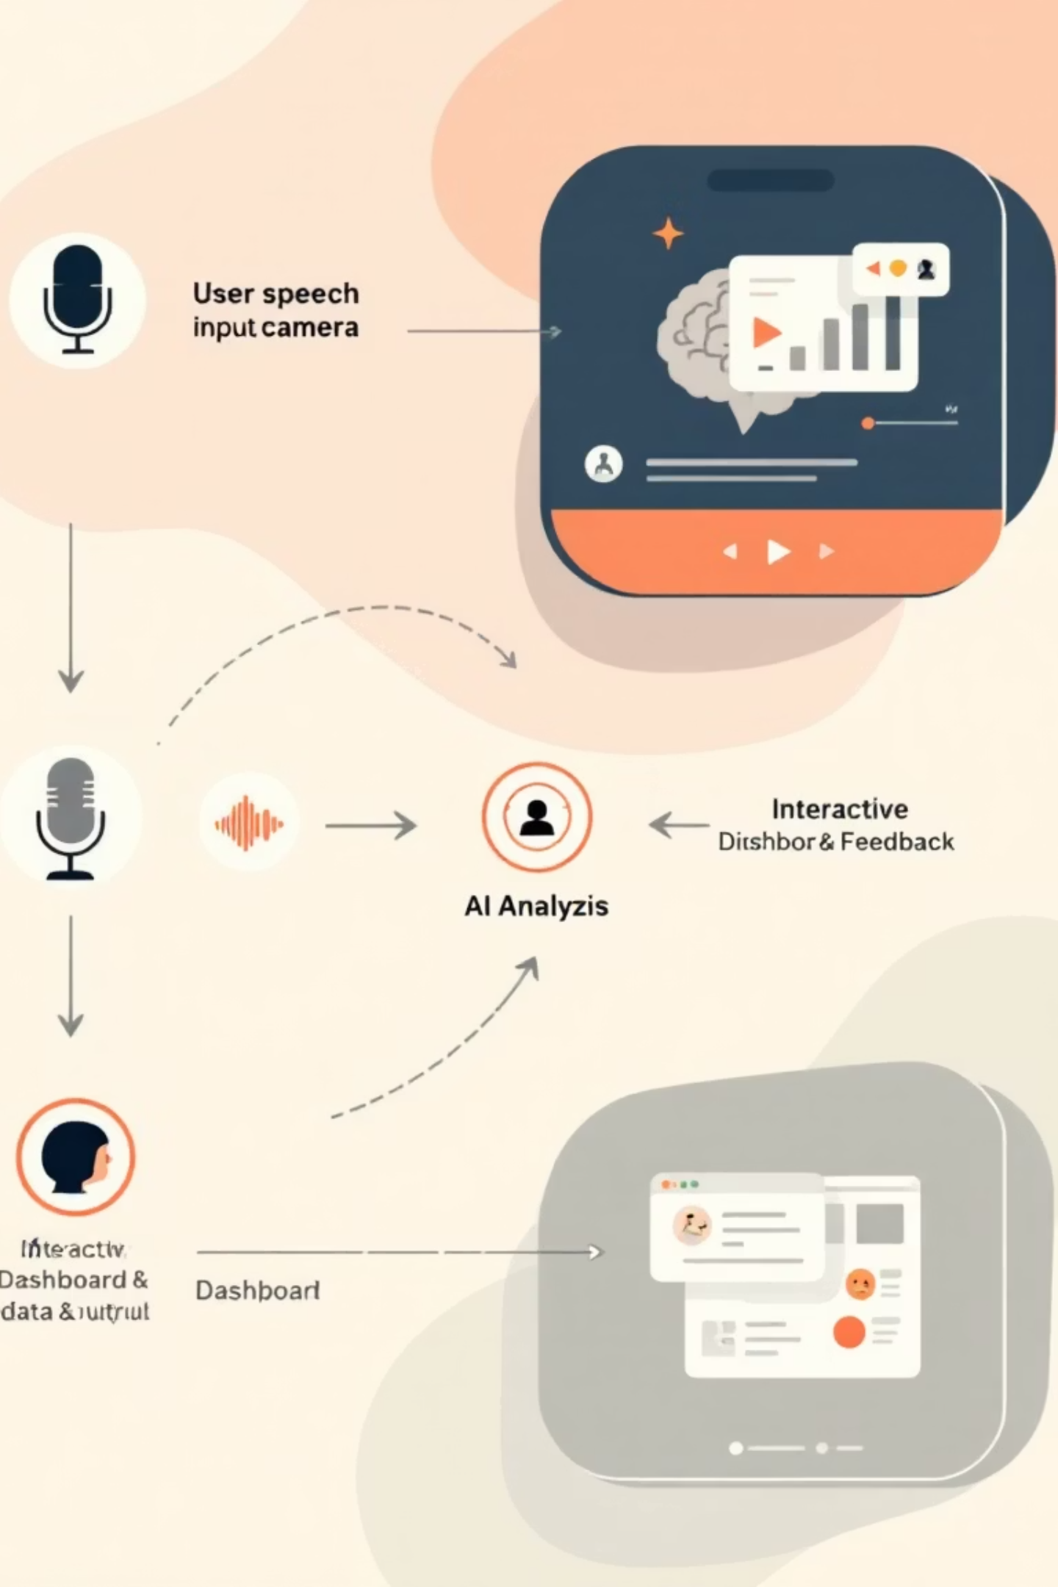



Introducing Our Exposure
Therapy
Our prototype offers a revolutionary solution, providing real-time, actionable insights to transform public speaking skills. It is used to analyze speech and emotion, delivering a comprehensive dashboard for continuous improvement.
Speech Analysis
Identifies filler words, analyzes pace, and assesses clarity.
Emotion Detection
Utilizes audio and video cues to interpret speaker emotions.
Interactive Dashboard
Presents improvement metrics in an intuitive and actionable format.

Slide 5

Prototype in Action: What's Implemented Today
Our current prototype provides a robust foundation for real-time speaking analysis, focusing on core functionalities that deliver immediate value to the user.
Seamless User Experience
Real-Time Practice Sessions
Actionable Performance Metrics
Intuitive login process leading to a comprehensive dashboard.
Audio and video input capture for live performance analysis.
Key indicators displayed include filler word count, repetition rate, and real-time emotional feedback via emojis, providing instant insights for improvement.

Slide 6




Unique Features: Beyond Standard Feedback
Our platform sets itself apart through several groundbreaking features crafted to foster a dynamic and immersive coaching experience, pioneering the boundaries of speaking.
Adaptive Audience Reaction
Real-Time Confidence Score
Virtual audience avatars respond in real-time, simulating audience engagement based on speech dynamics.
Dynamic scoring based on voice modulation, posture, and speaking patterns.
Emotion Feedback Loop
Multimodal Heatmap
Guidance on modulating emotional expression for greater impact and connection with the audience.
A unified visualization of audio, video, and text metrics, offering a holistic view of performance.

Slide 7
Technology Stack
Our model is built on cutting-edge open-source technologies, ensuring scalability, performance, and flexibility for future development.
Front-End &UI:
Tkinter
Audio Analysis:
Whisper (High-accuracy speech-to-text).
Natural Language Processing (NLP):
Transformers (Contextual understanding and text-based emotion detection)
Database:
SQLite (Efficient storage and retrieval of user practice metrics and preferences)

Slide 8
Future Scope & Strategic Roadmap
Our vision extends beyond the current prototype. We have a clear roadmap for introducing advanced features that will further enhance the user experience and expand the capabilities of our AI trainer.
Predictive Suggestions
Real-Time Coaching Tips
AI-driven recommendations for improving specific speaking habits based on patterns over time.
Contextual, in-session advice appearing as the user practices, guiding immediate adjustments.
1
2
3
4
Gamification & Badges
Multi-Language Support
Incentivizing consistent practice and skill mastery through interactive rewards.
Expanding our reach by enabling speech and emotion analysis in multiple languages.

Slide 9
Why We Stand Apart: Unparalleled Innovation
Our AI-Powered Public Speaking Trainer offers distinct advantages that set it apart from existing solutions, delivering a more comprehensive, adaptive, and engaging coaching experience.
Feature
Typical Competitors
Our Solution
Live Audience Reaction
None
✔
Multimodal Emotion Detection (Audio + Video + Text)
Audio only or limited text analysis
✔ (Holistic)
Adaptive Confidence Scoring
Basic confidence metrics
✔ (Dynamic & Contextual)
Predictive Insights & Improvement Roadmap
Post-session summaries
✔ (Proactive Coaching)
Invest in a solution that redefines public speaking mastery.

